Slide 1
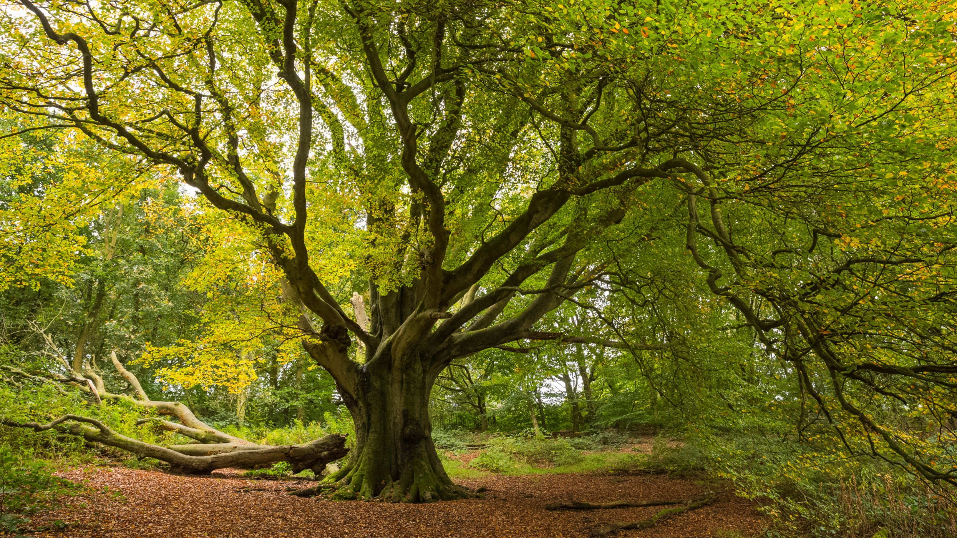
Trees

Slide 2
Trees: Some Terminology
A
root
B is a child of A
degree: number of children
A is the parent of E
B
B and C are siblings
C
D
E
F
G
H
I
J
K
leaf nodes

Slide 3
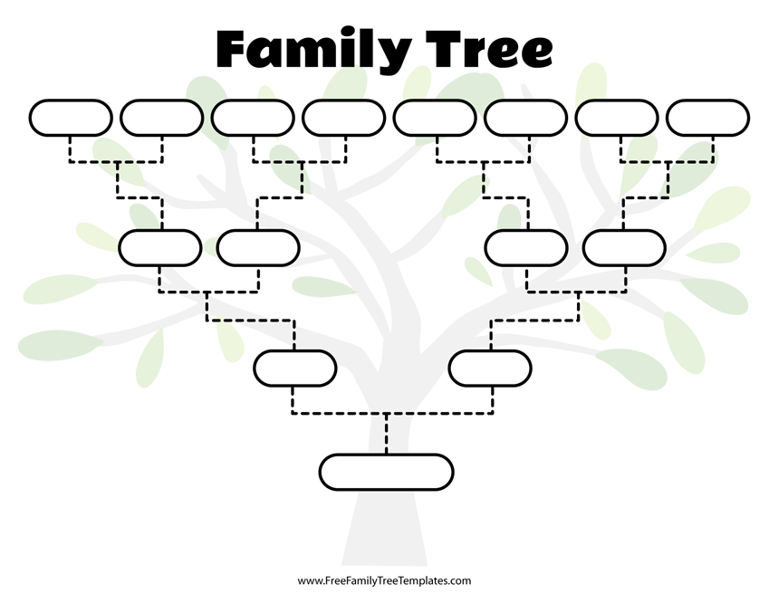
Trees are useful for representing hiearchies

Slide 4

Trees are useful for representing hiearchies

Slide 5
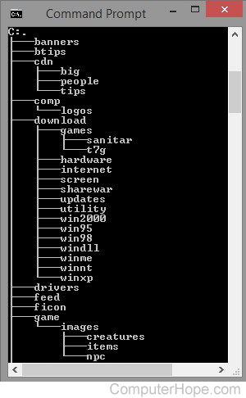
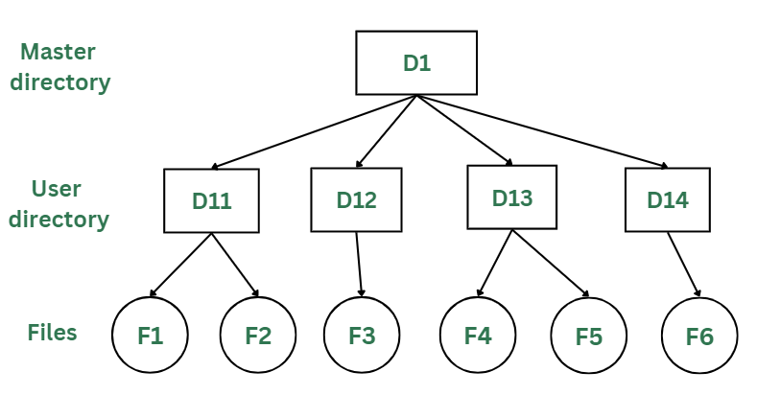
Trees are useful for representing hiearchies

Slide 6
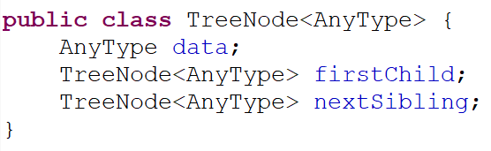
Tree Implementation
A
B
C
D
E
F
G
H
I
J
K
TreeNode:
B
data:
B
firstChild:
F
nextSibling:
C

Slide 7
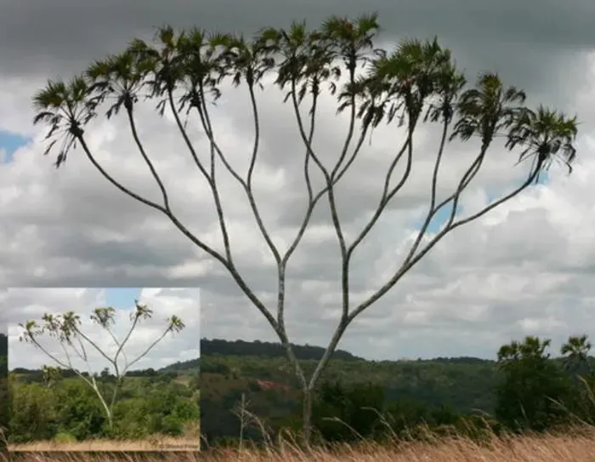
Binary Trees

Slide 8
Array Representation of a Binary Tree
1
A
2
3
B
C
4
5
6
7
Left Child: 2 x i
Right Child: 2 x i + 1
Parent: i // 2
D
E
F
G
12
Ğ
0 | 1 | 2 | 3 | 4 | 5 | 6 | 7 | 8 | 9 | 10 | 11 | 12 | 13 | 14 | 15
0 | 1 | 2 | 3 | 4 | 5 | 6 | 7
 | A | B | C | D | E | F | G |  |  |  |  | Ğ
 | A | B | C | D | E | F | G

Slide 9

Binary Search Trees

Slide 10
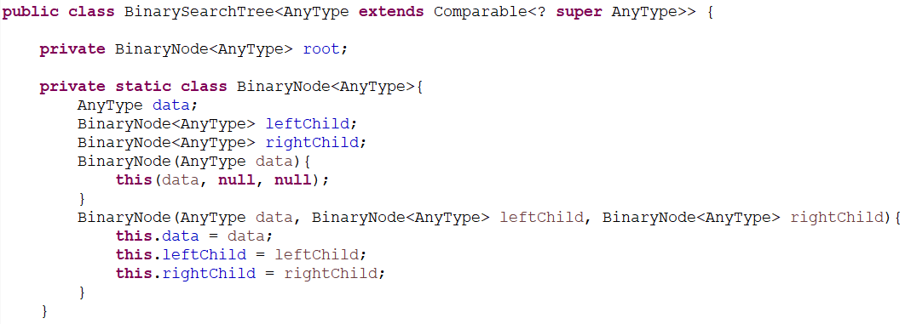
Binary Search Tree Implementation

Slide 11
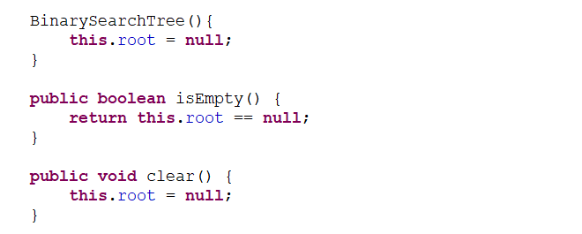

Slide 12
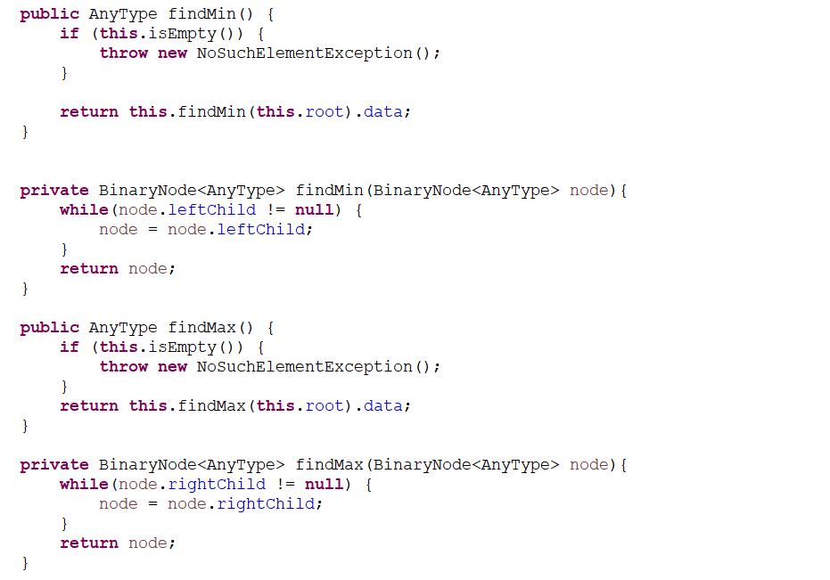

Slide 13
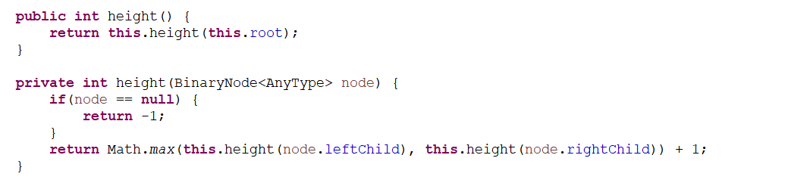

Slide 14
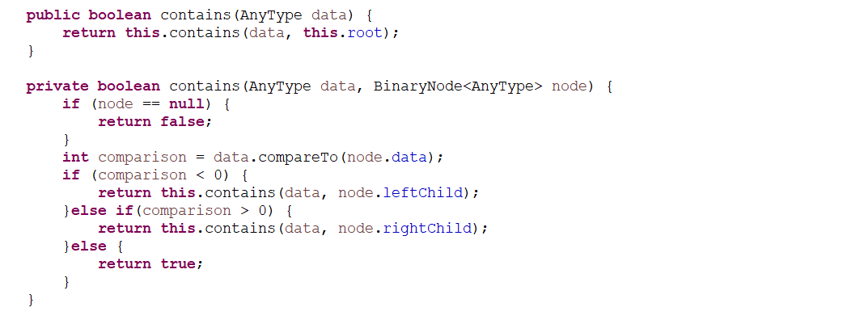

Slide 15
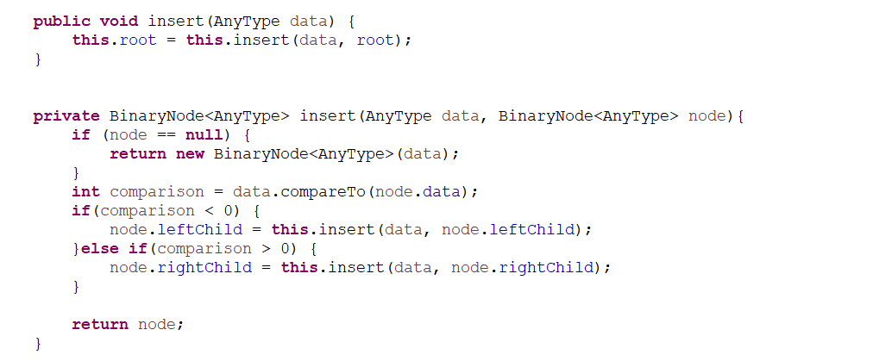

Slide 16
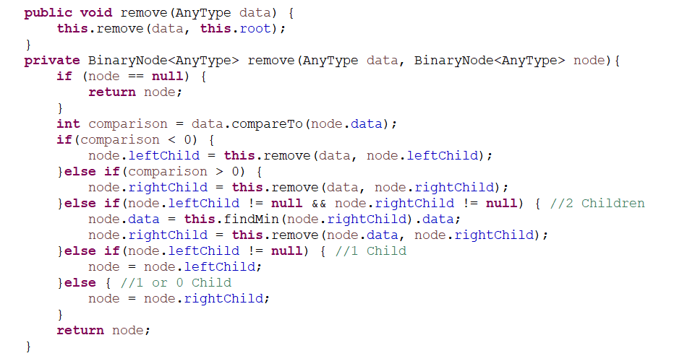

Slide 17
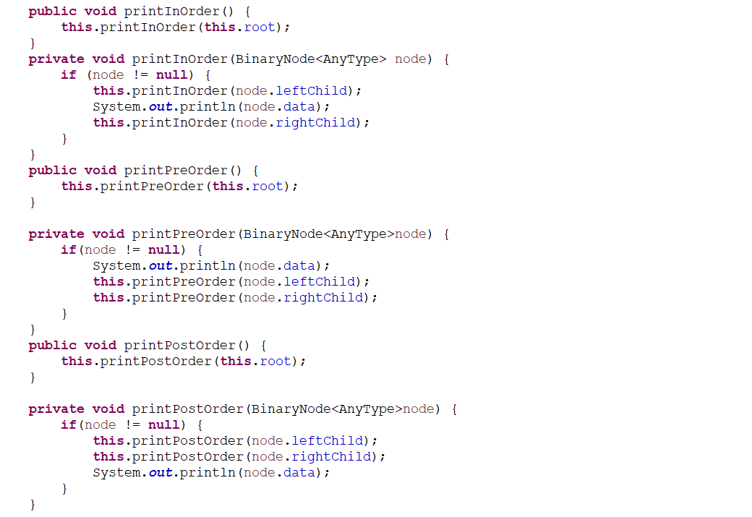

Slide 18
Recommended LeetCode Questions
1038: https://leetcode.com/problems/binary-search-tree-to-greater-sum-tree/
1339: https://leetcode.com/problems/maximum-product-of-splitted-binary-tree/
1161: https://leetcode.com/problems/maximum-level-sum-of-a-binary-tree/
1457: https://leetcode.com/problems/pseudo-palindromic-paths-in-a-binary-tree/
2096: https://leetcode.com/problems/step-by-step-directions-from-a-binary-tree-node-to-another/
513: https://leetcode.com/problems/find-bottom-left-tree-value/
2509: https://leetcode.com/problems/cycle-length-queries-in-a-tree/
515: https://leetcode.com/problems/find-largest-value-in-each-tree-row/
1461: https://leetcode.com/problems/check-if-a-string-contains-all-binary-codes-of-size-k/

